Slide 1
Python Lesson 1

Slide 2
Python Class Rule
Communication ! Communication ! Communication!
Be open minded
No such thing as a stupid question

Slide 3


Introduction
Coding is a way to tell computer what to do.
Natural languages
Formal languages
English:
How much tips should I pay for my dinner?
Python (or other high-level language)
Find my dinner cost based on my input
Tip=dinner cost *15%
Have tip output
Lower level language and machinery language (based on my imagination…)
1. Store first number in the position 196865832.
Calculate 15%*the first number. (This may also complicate because use different way to do multiply.
Store the output number in position123423423.
Have this output.
Binary
0100010010010001…
What we want to cover
Programming languages are formal languages that have been designed to express computations.

Slide 4
What are the components for a code(a function)
Input
conditional statement
Math
Repetitive calculation
output

Slide 5
Introduction
Why Python?
If you are a aliens visit earth .. What language what do you want to pick? What is your consideration?
English is Easy to learn and use
English is universal…
A lot of good books are translated to English and most of top-level research paper is written by English
English has grammar..
Python is easy to learn and use.
Python can run in different operation system.
Python is open source, people from different community are contributing. Python is leveraging on C library.
Python has its syntax

Slide 6
Algorithm and Pseudocode
The sets of steps to do any task in computer is called Algorithm
Pseudocode is an algorithm written in an informal, simple nature language.
Calculate cost for my dinner at a restaurant
Input my dinner cost.
Look up my state tax. Tax=dinner cost *8.25%
Tip=dinner cost *15%
Have total amount print on the screen.
Set up table for thanksgiving
Repeat 4 times following
go to next empty place on table
put a bowl at this place
place a napkin to the left of the bowl
place a spoon to the right of the bowl

Slide 7
Lab 1
First python code ever…
What is bug and how to debug?

Slide 8
Appendix
1. How to install Jupyter notebook
2. How to set up Github

Slide 9
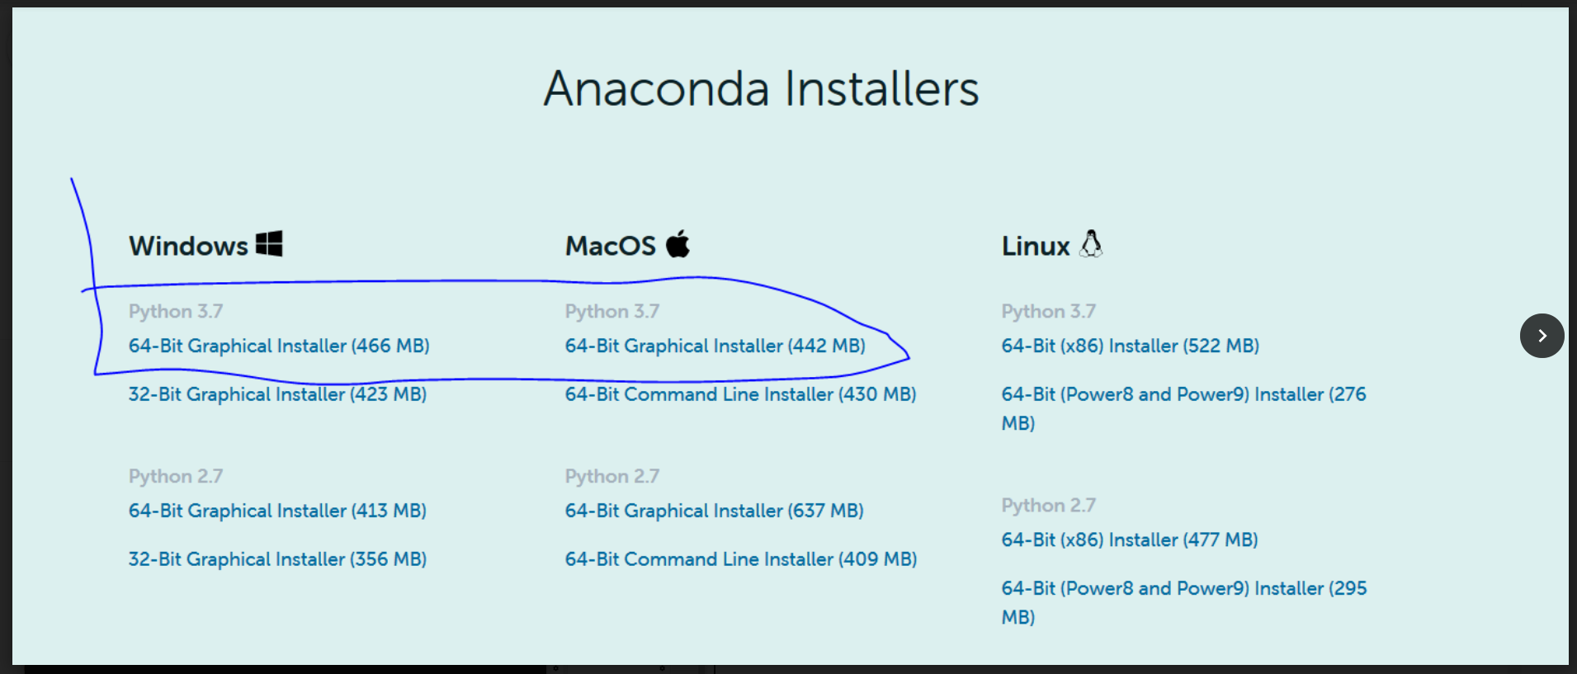
1. First you need to download Anaconda.
https://www.anaconda.com/products/individual
(Scroll down to the bottom, you will find the link for installers)

Slide 10
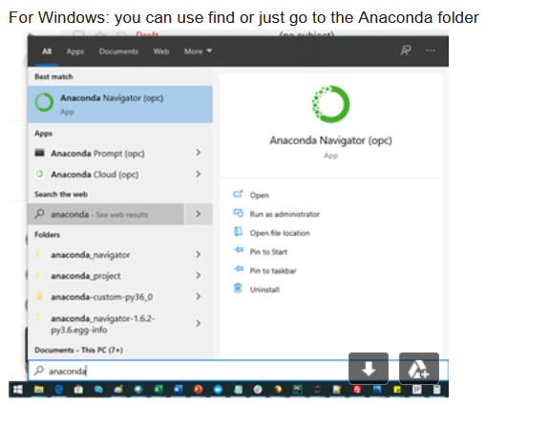
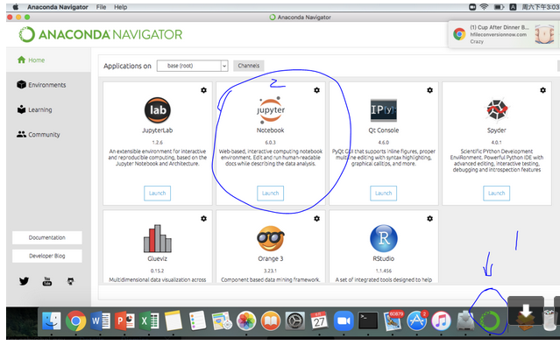
2. Install Anaconda (follow the instructions, should take less than 10 mins)
3. Go to Anaconda Navigator (if you use mac, please hit the Anaconda label as shown below, if you use Windows, you can find it from the "start".
Then you can find Jupyter Note book label, hit "Launch"...

Slide 11
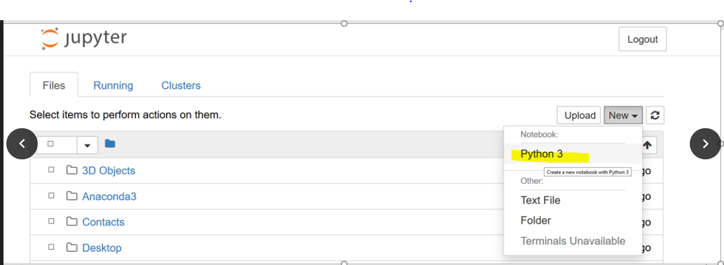
4. First Test:
a) inside your Jupyter Notebook, choose Python 3.
b) test your code

Slide 13
Set up Github

Slide 14
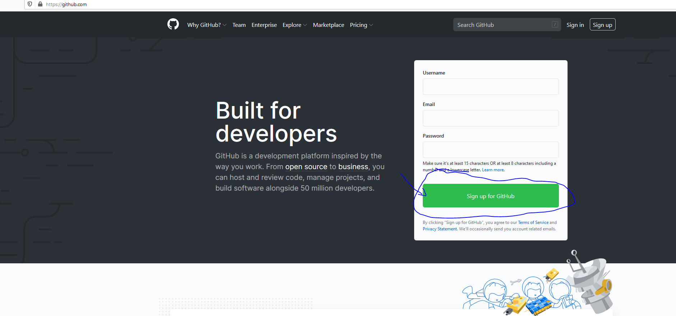
Step 1: Go to github.com and hit sigh up for Github.
https://github.com/

Slide 15
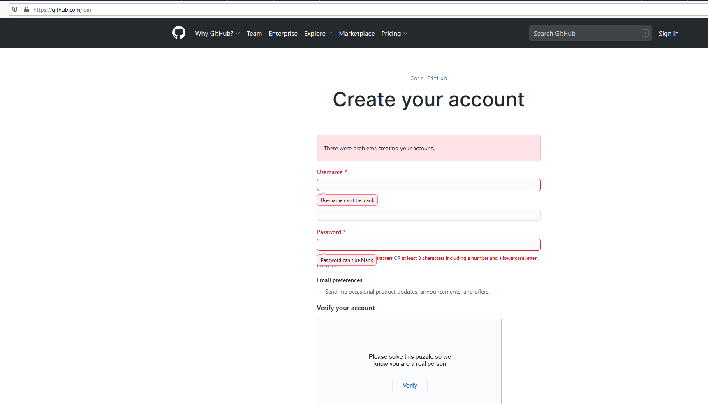
Step 2 : you will see following form, just fill that form and you get your github account !!
You need to have an email address associate with your github.

Slide 16
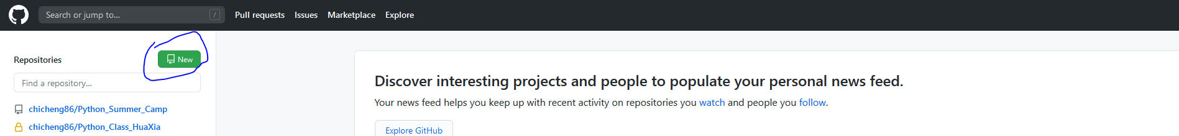
Step 3: After you sign in your GitHub account, go to your top-left, hit new button next to repositories.

Slide 17
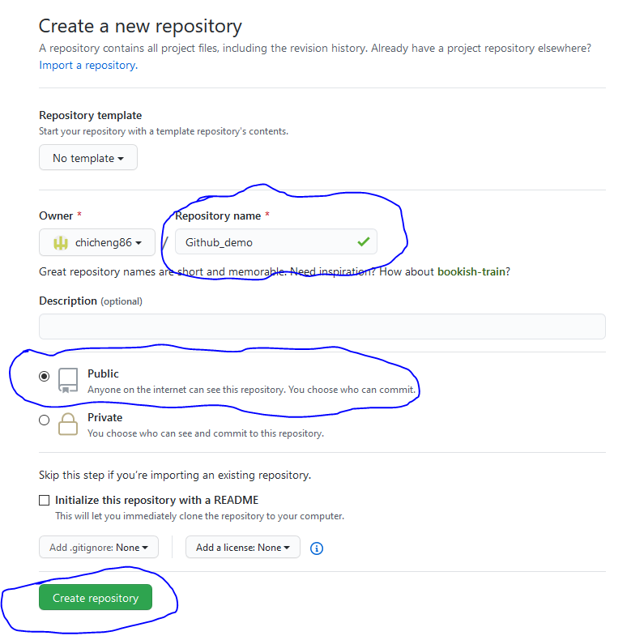
Step 4: Give a name for your repository, choose privacy and hit create repository.
You can also choose to make your repository private. But please make sure to invite me as your collaborator… Then I can see your code :
https://help.github.jp/enterprise/2.11/user/articles/inviting-collaborators-to-a-personal-repository

Slide 18
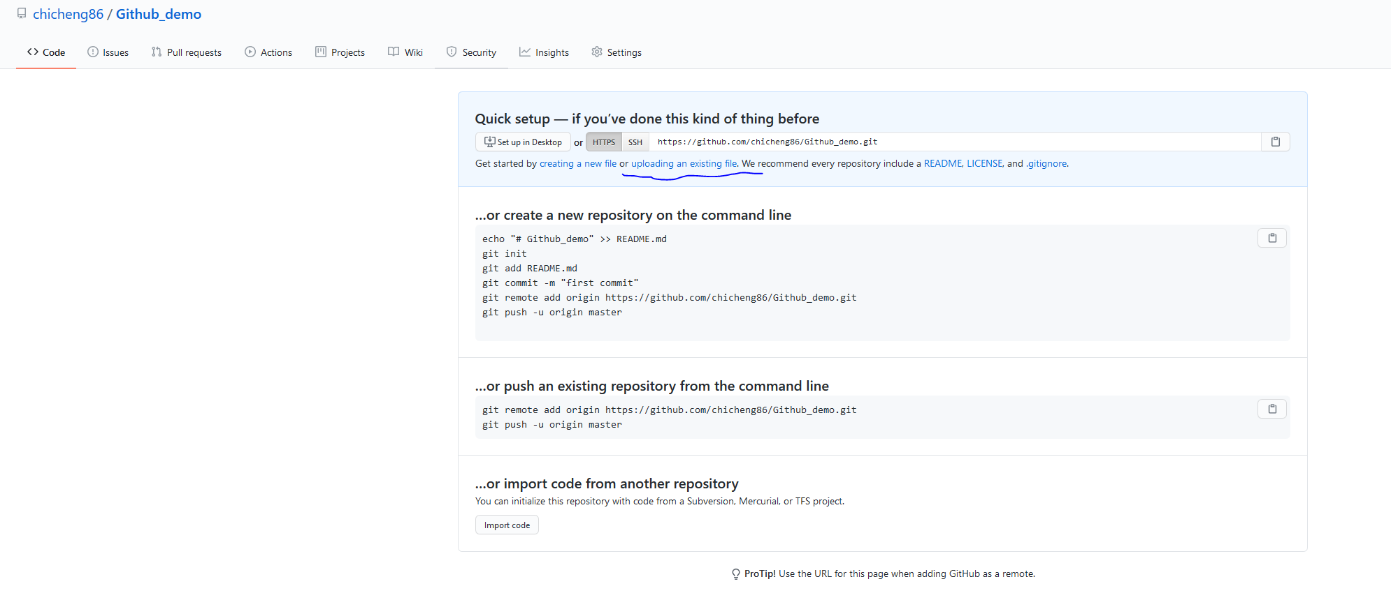
Step 5: After you done, you see following. Hit uploading an exiting file

Slide 19
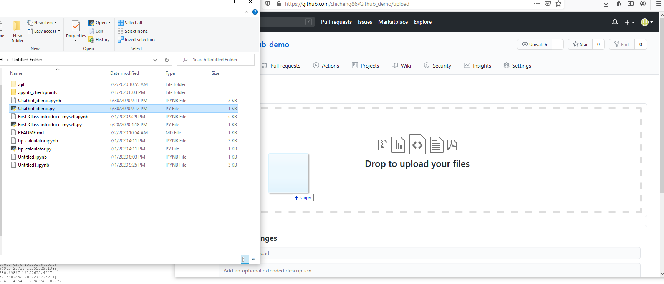
Step 6: Drag your file to the box ~

Slide 20
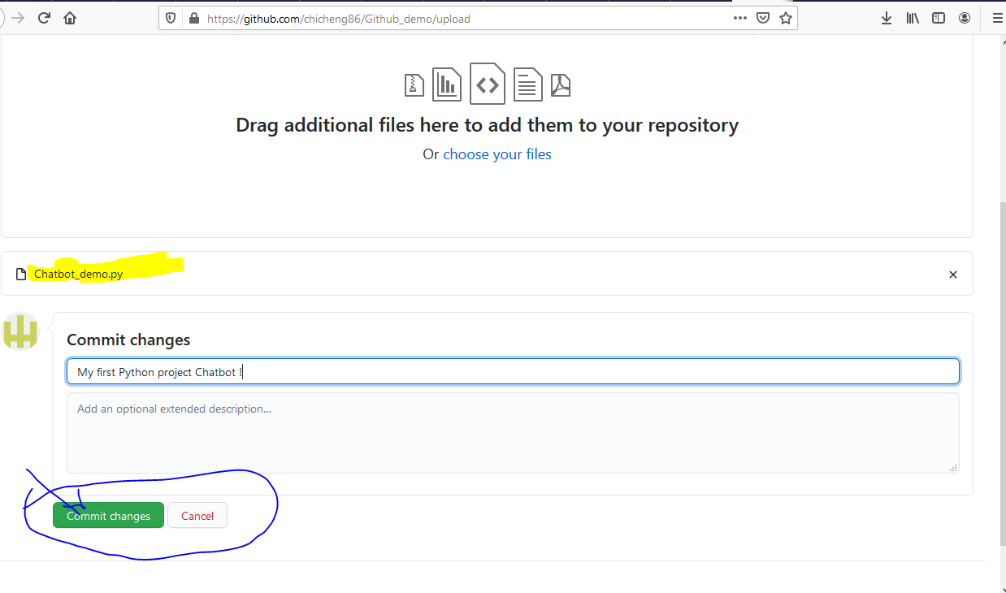
Step 7: if your file get uploaded, you will see the filename in the yellow highlighted area. Put your comments and hit commit changes.

Slide 21
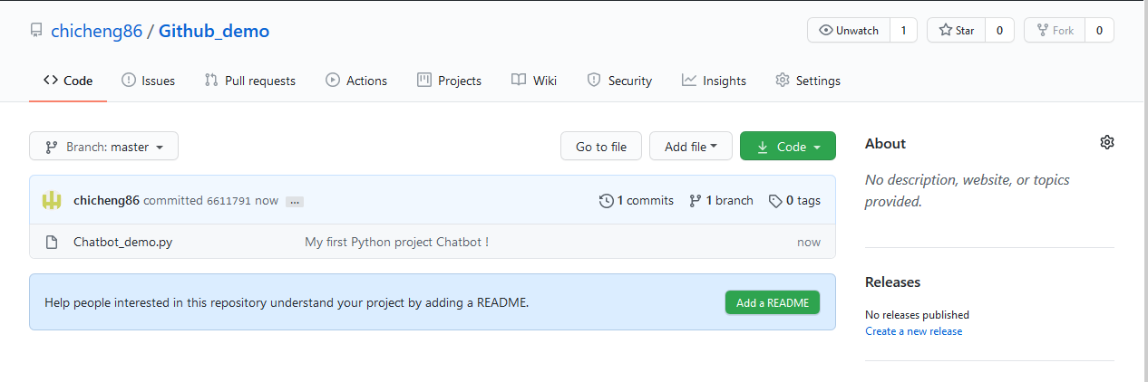
After commit change, you can see that show up in your repository.

Slide 22
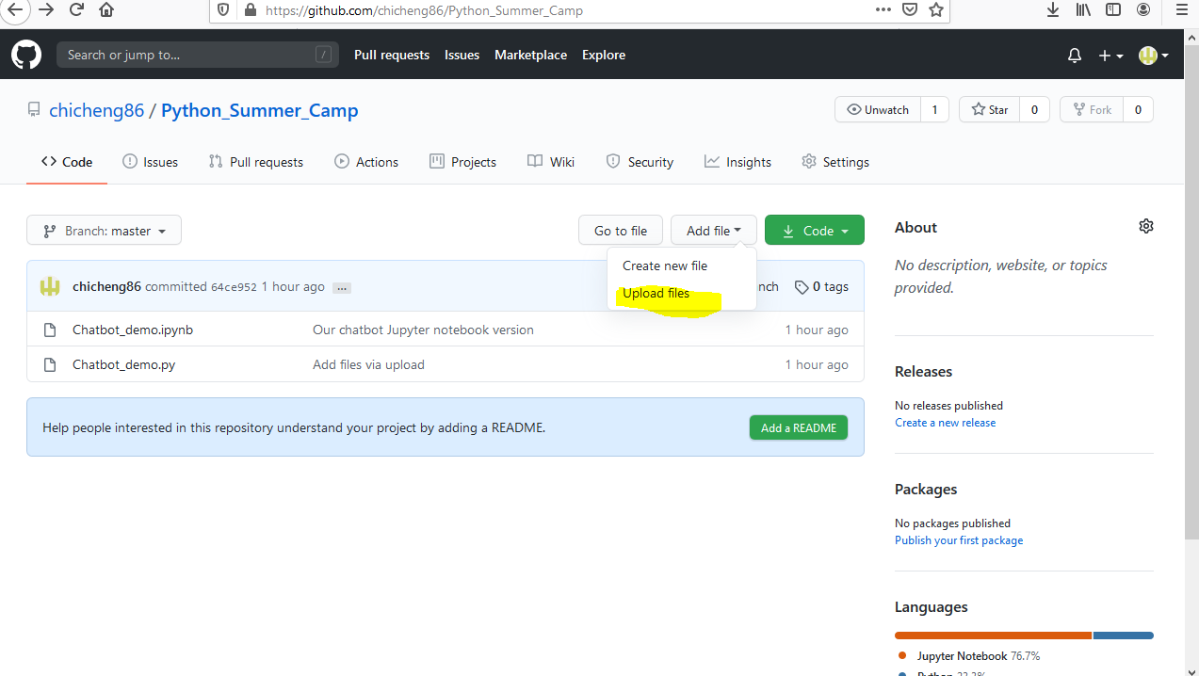
Step 8, if you want to upload more files, always go to “Add file” then “upload files”.

